Slide 1

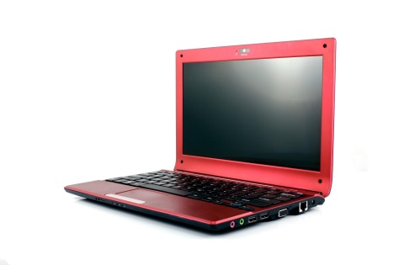
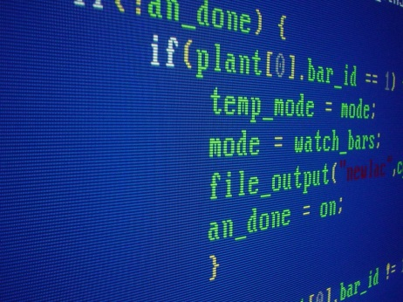
Computer Science
How I find myself like this subject?
When I was in high school, I took computer science class. On the first day of the class, the teacher told us to code a program that outputs
“Hello World!!”
on the display. Even though this is the simplest program that anyone can write, I was very impressed with the fact that I told the computer what to do. I was attracted to programming by one simple program.
Why is this subject important?
I think computer science is important because there is a big demand for computer technologies. Can you imagine this graphic calculator has much better calculation than the “super computer” that was used in Appolo program? And the computer technology is still developing nowadays. This is why I think my subject is important.

Slide 2


Conflicts
I think one of the big conflicts/arguments existing within computer science is the structure of computers. Although computer technologies are developing so fast, how the computers work stays the same since the first computer was created. Since there may be limits for CPU or Memory to develop, specialists say we need to find new structure for computers other than just updating or improving the same computer structure.
Future Potential
Almost all fields or subjects use computers to do their studies. So I think there is a big future potential for this subject.
Architecture-Use computers to simulate how buildings react to earthquakes.
Physics-Simulate how objects act.

